Slide 1


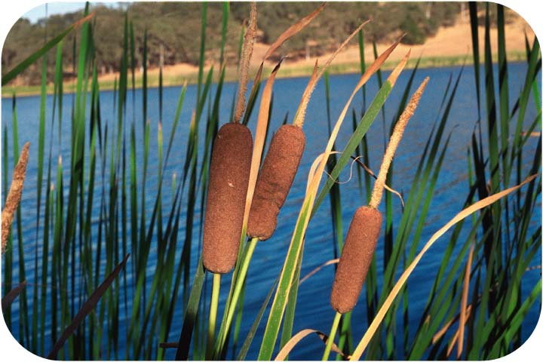
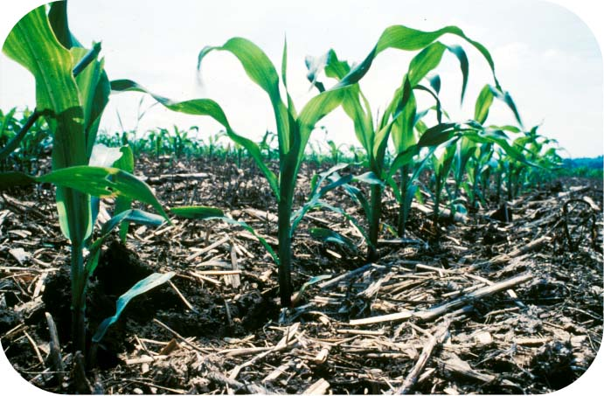
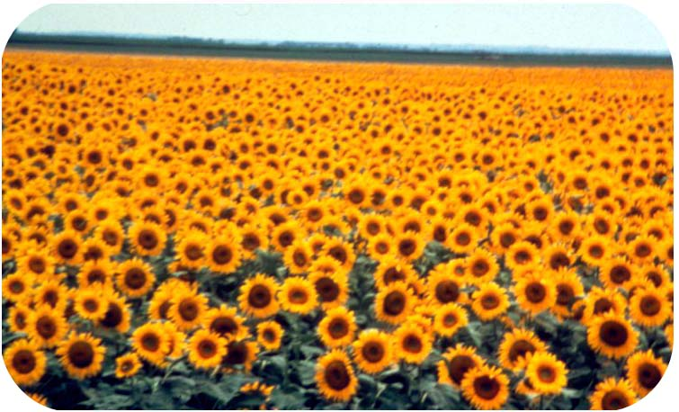
A
g r i S u r v e y
A Lightweight Web Application Group H
Overview
AgriSurvey is a lightweight web application for conducting agricultural field surveys. It lets users record farm details, manage crop information, log soil and water samples, and report pests and diseases. Designed for intuitive, efficient data collection, it empowers better decision‑making and resource allocation in the agricultural sector. Enumerators can quickly capture and save data in the field, then sync to a central database when online.
MVC Framework Explanation
Module: We designed 6 modules. The Farm and Crop module to store their information, the Soilsample and Watersample module to store soil and water information, and the PestDiseaseReport module to store pest and disease report information.
View: We use HTML, CSS, and JavaScript to provide a responsive, interactive user experience.
Controller: Process user requests, obtain data from the model, and pass it to the view for display.
The application is structured into four main functions:
Auth and Route Assignment: This part handles user authentication and assigns specific fields or farms to each enumerator.
Farm and Crop Details: This part allows users to record essential information about the farm, including size, owner details, GPS boundaries, and the crops planted.
Soil and Water Sampling: This part enables users to log soil parameters such as pH, moisture, and nutrient levels, as well as upload water quality photos and readings.
Pest and Disease Reporting: This part captures pest sightings and disease symptoms, allowing users to upload photos and text descriptions. It also includes a feature to flag hotspots and alert agronomists.

Slide 2
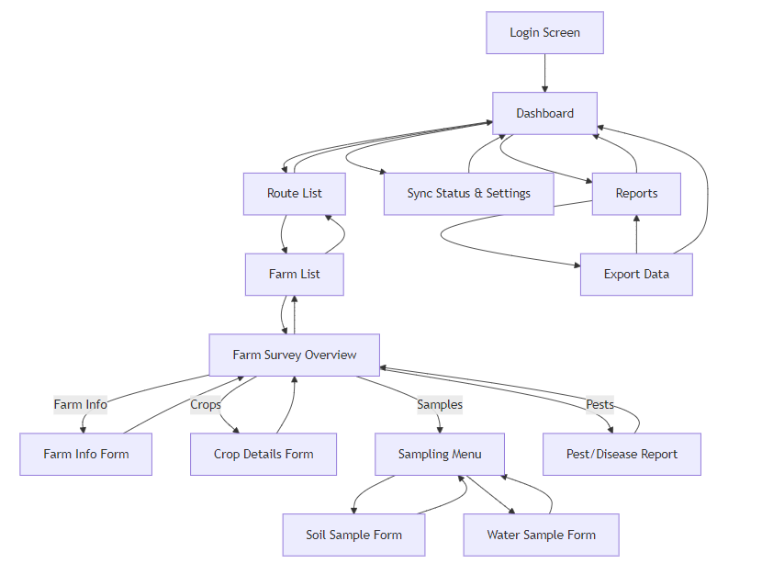
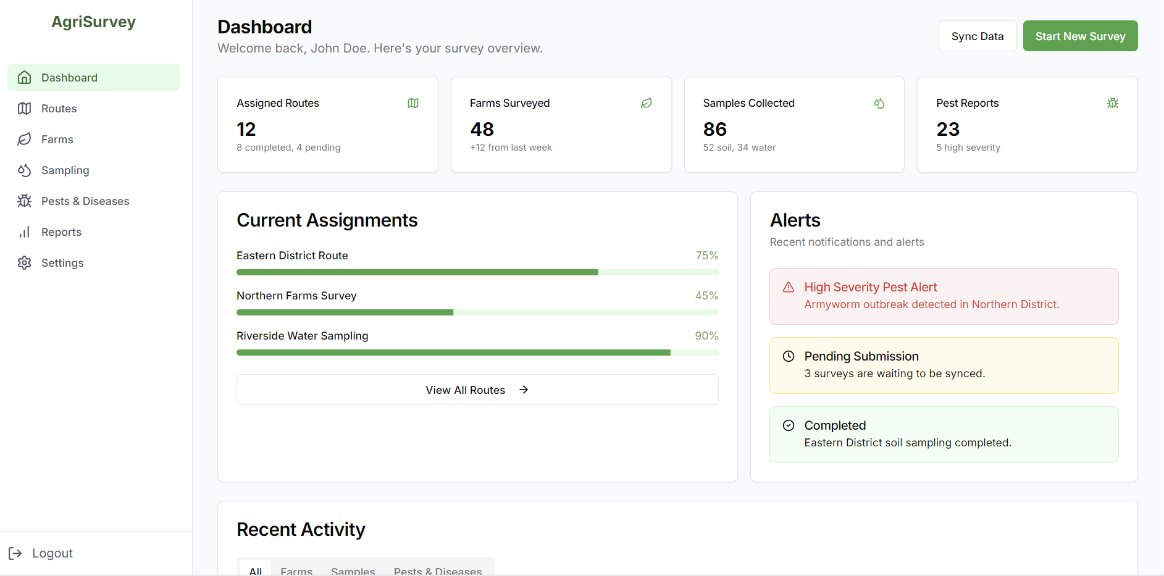
A
g r i S u r v e y
A Lightweight Web Application Group H
Screenshots(Dashboard)
Navigation Chart / UI Flow

